Slide 1

An Introduction to Julia
By Tyler Cabutto and Sean Heeney

Slide 2
What is Julia?
“Julia is a high-level, high-performance dynamic programming language for numerical computing. It provides a sophisticated compiler, distributed parallel execution, numerical accuracy, and an extensive mathematical function library. Julia’s Base library, largely written in Julia itself, also integrates mature, best-of-breed open source C and Fortran libraries for linear algebra, random number generation, signal processing, and string processing. In addition, the Julia developer community is contributing a number of external packages through Julia’s built-in package manager at a rapid pace. Julia, a collaboration between the Jupyter and Julia communities, provides a powerful browser-based graphical notebook interface to Julia.”
Notes:
https://julialang.org/

Slide 3

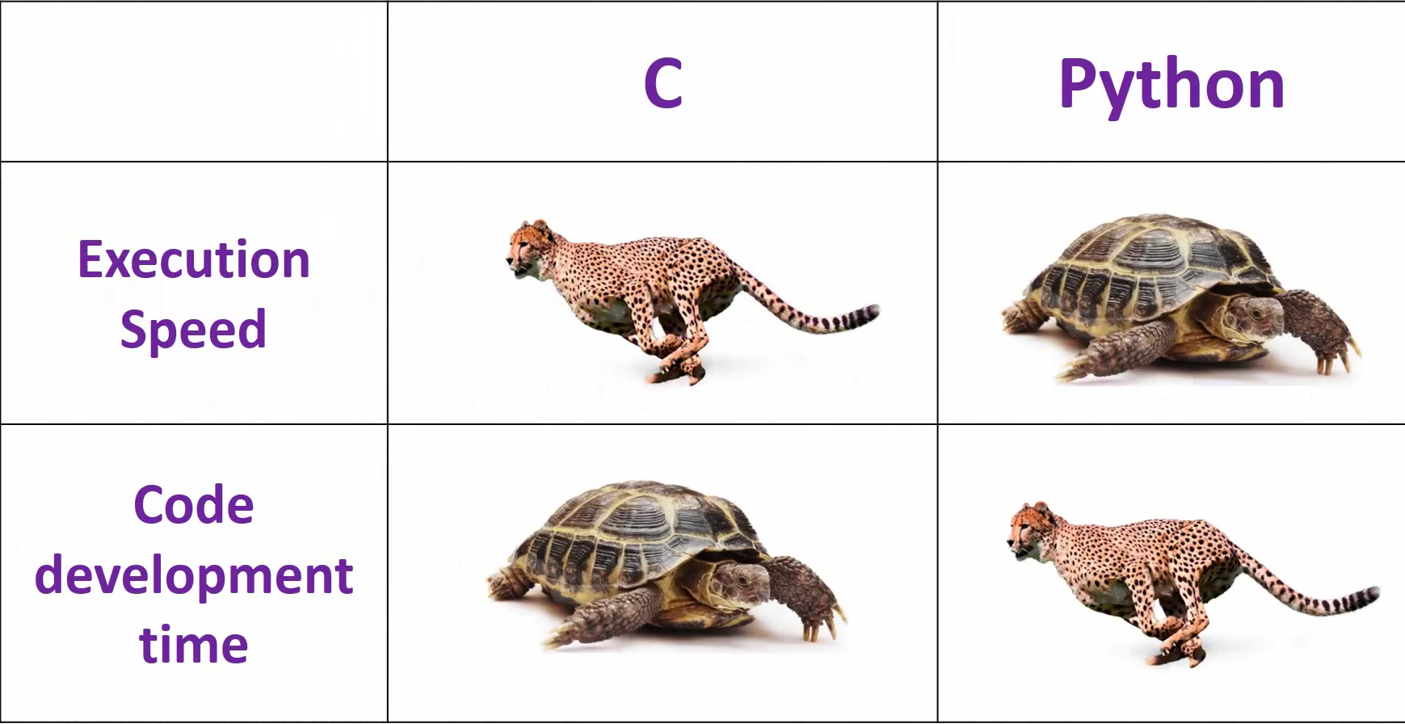



Speed of Julia
“Julia complies codes on the fly, reaching an incredible velocity. Julia combines the method of interpreting languages, such as Python, that transform the code into bytecode on the fly, with compiled languages (C/Fortran), that compile their code into machine code and then running the resulted executable.”
“Just In Time (JIT) compilation preserves memory and save time during application initialization. Just In Time (JIT) compilation is used to run at high speed, after an initial phase of slow interpretation. Just In Time Compiler (JIT) code generally offers far better performance than interpreters.”
The first time a program is run it will be slower than the following instances.
Notes:
https://economictheoryblog.com/2017/09/30/why-use-julia-language/
http://vb.net-informations.com/framework/just_in_time_compiler.htm
https://www.youtube.com/watch?v=x0lI4omOYTw

Slide 4
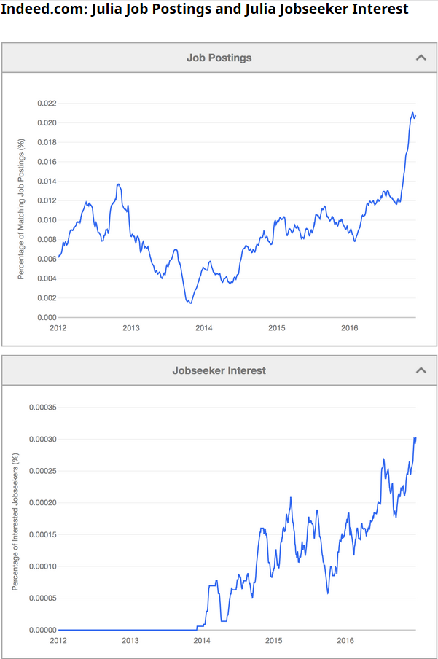
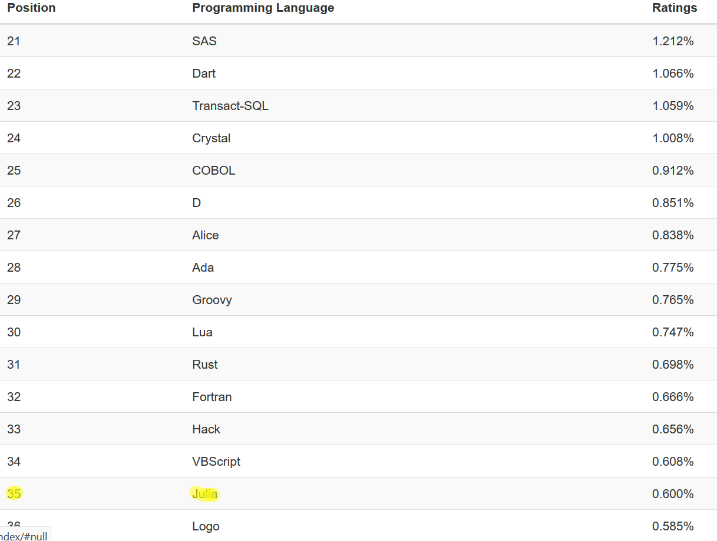
Popularity of Julia
The TIOBE index shows that Julia broke the top 50 in September of 2016, and as of November 2017, it sits at number 35.
Big companies like Apple, Amazon, Facebook, etc. are looking to hire Julia programmers in 2017.
Notes:
https://www.tiobe.com/tiobe-index/
https://juliacomputing.com/blog/2017/02/03/newsletter.html

Slide 5
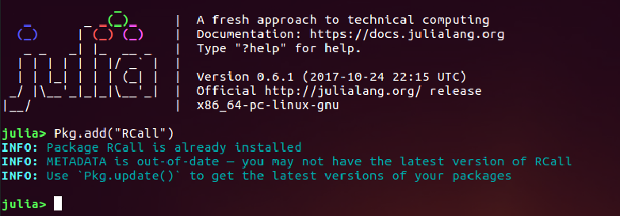
Packages
Julia has a built-in package manager for installing add-on functionality written in Julia. It can also install external libraries using your operating system's standard system for doing so, or by compiling from source.
“Julia also provides the possibility to resort to C, Fortran and Python packages, making it easy to run existing code. Finally, Julia’s compiler ability encourages the community to continue to develop packages in pure Julia,”
Notes:
https://docs.julialang.org/en/stable/manual/packages/
https://economictheoryblog.com/2017/09/30/why-use-julia-language/

Slide 6
Macros
“Like Lisp, Julia represents its own code as a data structure of the language itself. Since code is represented by objects that can be created and manipulated from within the language, it is possible for a program to transform and generate its own code.”
Notes:
https://docs.julialang.org/en/stable/manual/metaprogramming/

Slide 7
Departures from Other Dynamic Language Conventions
The core language imposes very little; the standard library is written in Julia itself, including primitive operations like integer arithmetic.
A rich language of types for constructing and describing objects, that can also optionally be used to make type declarations
The ability to define function behavior across many combinations of argument types via multiple dispatch
Automatic generation of efficient, specialized code for different argument types (Macros)

Slide 8
Inspiration for Julia
Convenience: dynamic languages like Python.
Integration of speed of languages like C.
Ultimately, the idea was to have a language that “walks like python and runs like C”.
Notes:
https://juliacomputing.com/blog/2017/02/03/newsletter.html

Slide 9
Brief History and Philosophy of Python
“Python is an interpreted, interactive, object-oriented programming language that incorporates modules, exceptions, dynamic typing, very high level dynamic types, and classes into it”.
Released by Guido Van Rossum in February of 1991; his wish was to fix the syntax in the ABC language and to allow system calls to the Amoeba OS.
Keeps the UNIX philosophy of “doing one thing well”.
Interpreted instead of compiled. This acts as a limitation to the speed of execution compared to compiled languages.
Notes:
http://groups.engin.umd.umich.edu/CIS/course.des/cis400/python/python.html
http://groups.engin.umd.umich.edu/CIS/course.des/cis400/python/python.html

Slide 10
Brief History and Philosophy of C
Developed back in Bell laboratories in 1972 by Dennis Ritchie.
Inspired by B, BCPL and CPL.
Handled low level operations well. This allowed the UNIX operating system to be rewritten from assembly language into C.
C bridged the gap between low level assembly language and other high level languages.
Highly structured. Programmer may break a program up with reusable functions.
No run time checking. If code compiles, it will run. This program may later crash due to logic errors.

Slide 11
Benefits of Julia
Free and open source (MIT licensed)
User-defined types are as fast and compact as built-ins
No need to vectorize code for performance; devectorized code is fast
Designed for parallelism and distributed computation
Lightweight “green; threading (coroutines)
Unobtrusive yet powerful type system
Elegant and extensible conversions and promotions for numeric and other types

Slide 12
Benefits of Julia
Efficient support for Unicode, including but not limited to UTF-8
Call C functions directly (no wrappers or special APIs needed)
Powerful shell-like capabilities for managing other processes

Slide 13
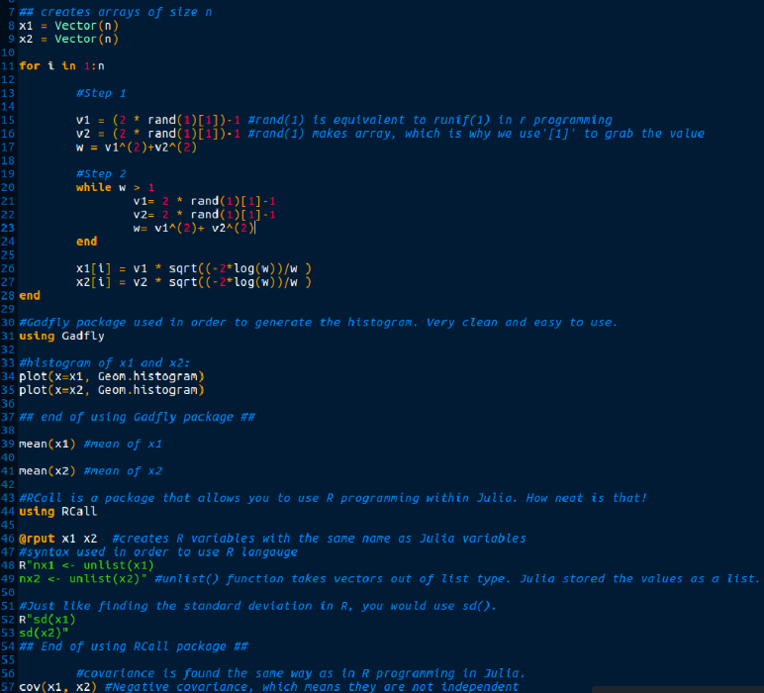
Marsaglia Polar method
To show an example of how Julia works, we will demonstrate the Marsaglia Polar problem from test 2 re-written in Julia.

Slide 14
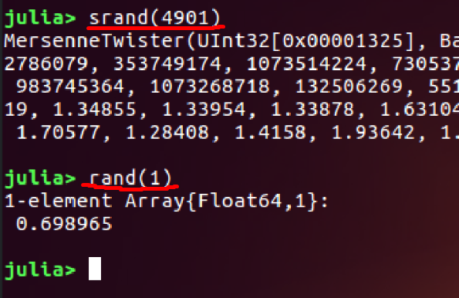
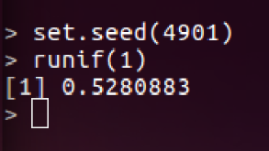
Different values
Julia seed
R programming seed
There will be slightly different values when running the Julia code due to the RNG generating a different value.

Slide 15
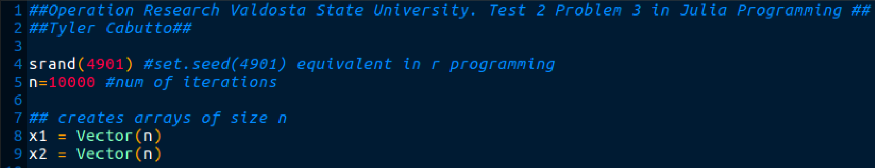
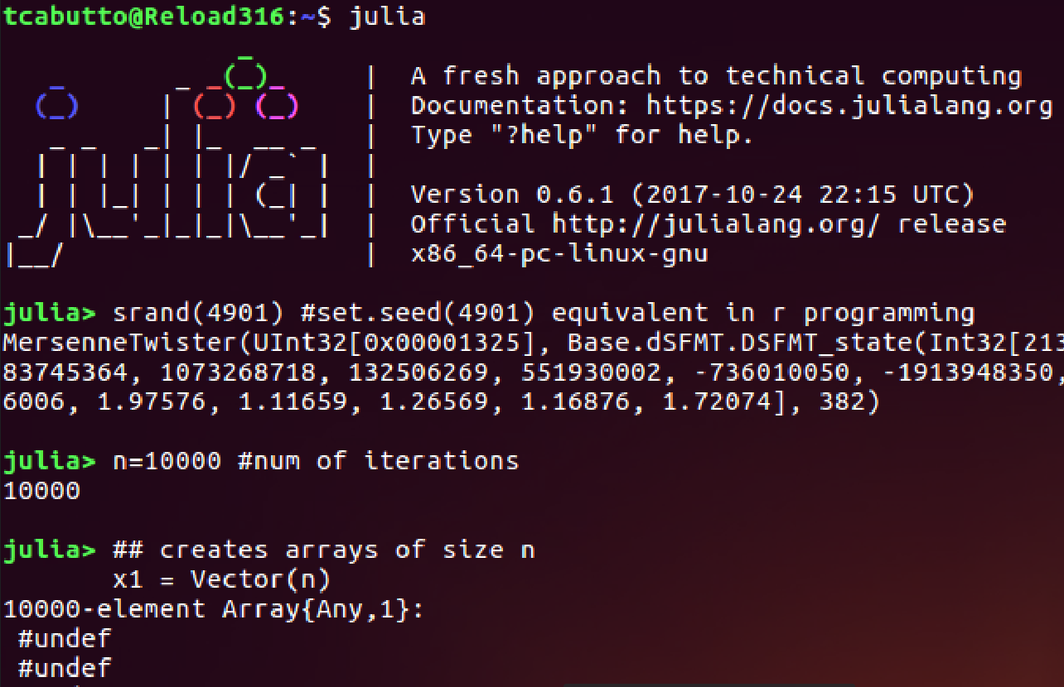

Slide 16
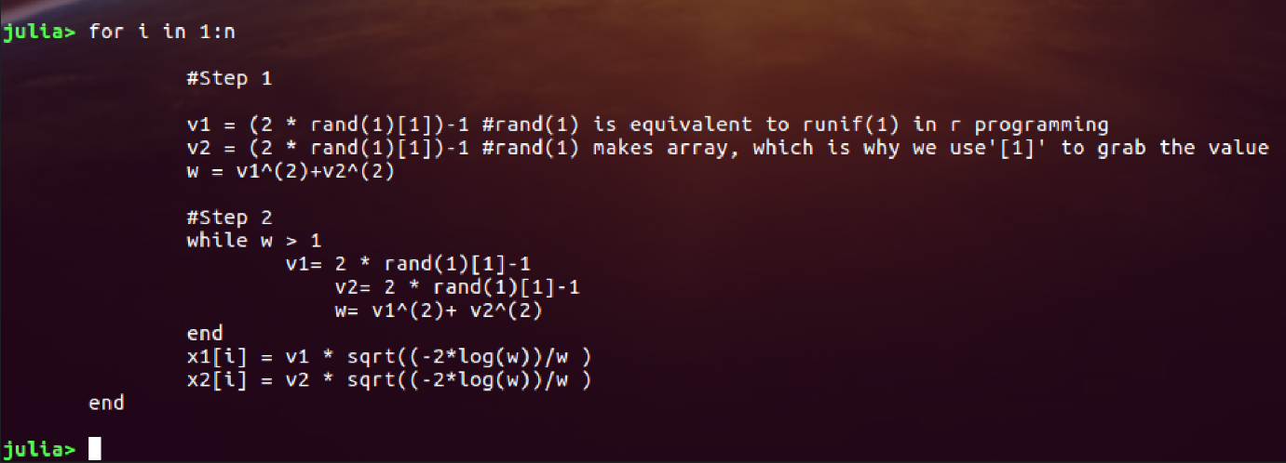
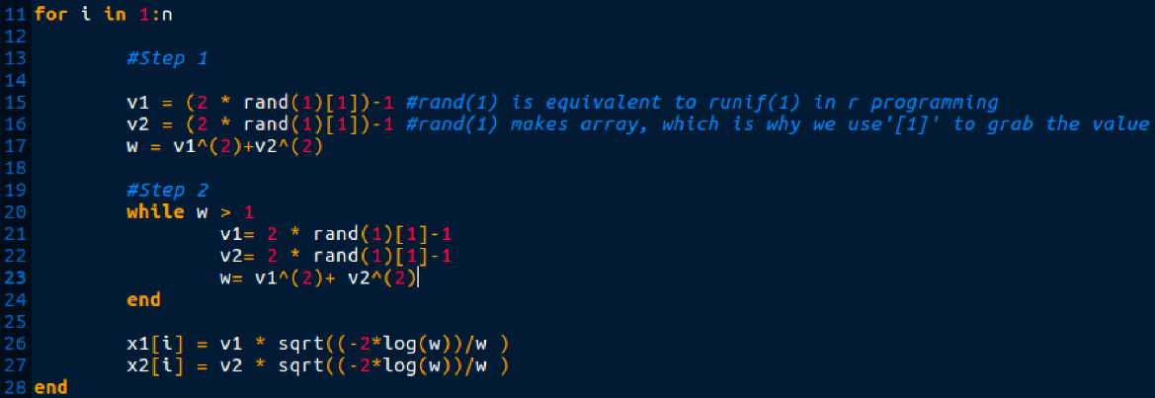

Slide 17
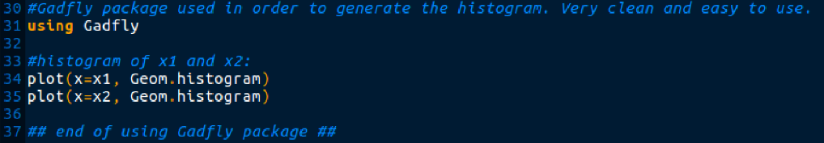
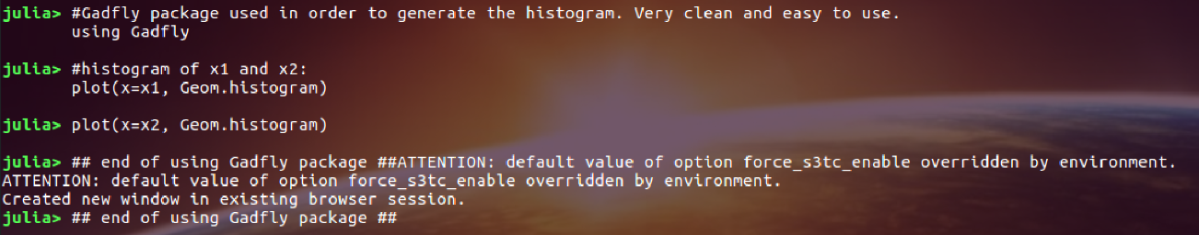

Slide 18
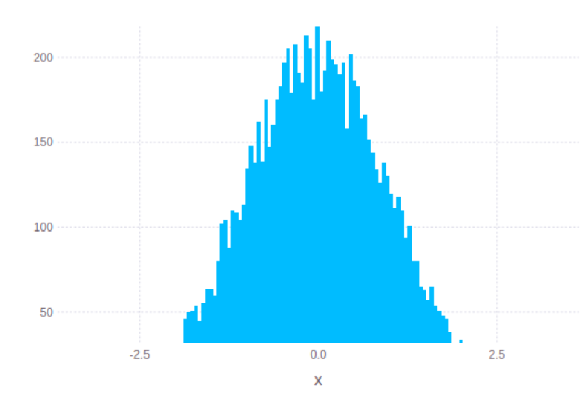
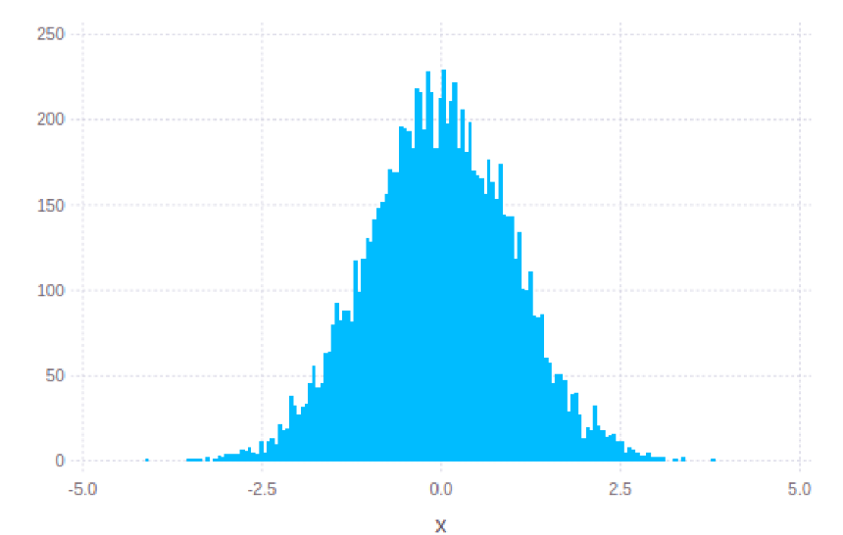
Results of histograms
X1
X2

Slide 19
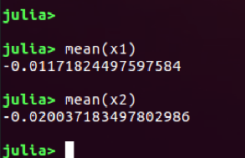

Slide 20
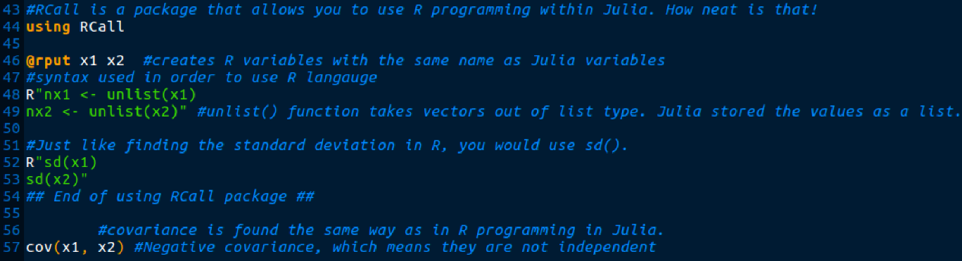
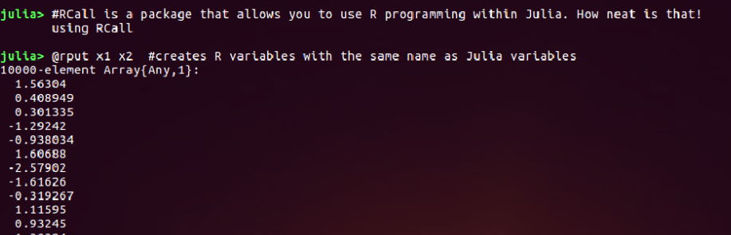

Slide 21
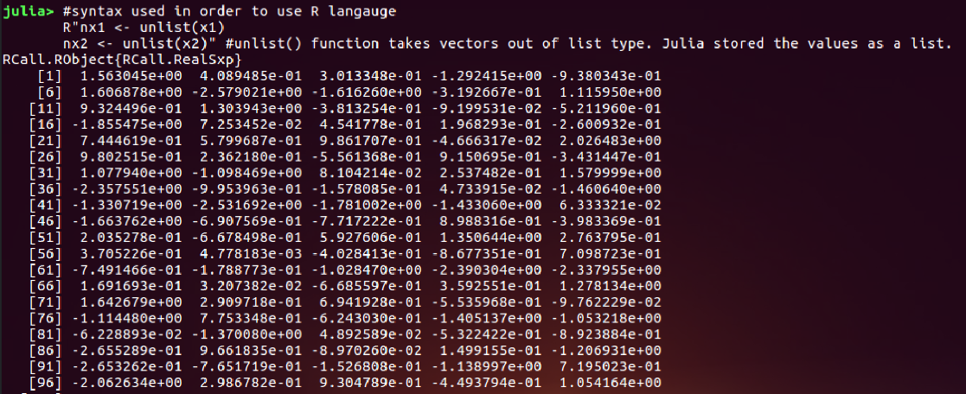

Slide 22
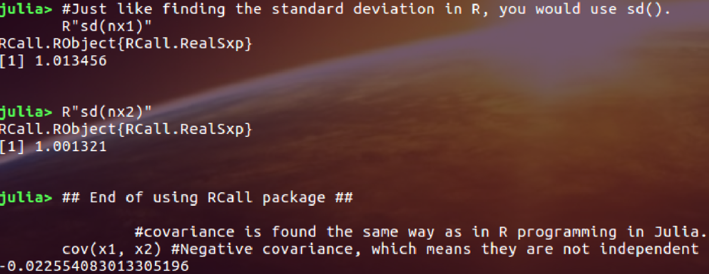

Slide 23
Which will run faster? Julia or R?

Slide 24
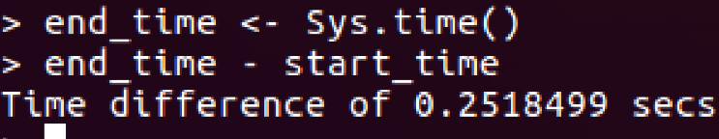
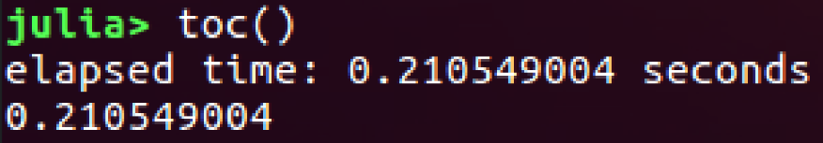
Runtime Results
Julia ended up being 0.041300896 seconds faster!

Slide 25
Conclusion
There is some staying power for Julia. They will have to be successful by maintaining a strong and loyal fanbase to keep the library growing and improving.
Another key factor would be holding up to the promise of performance and improving.
For scientific computing, Julia may very well take over if it continues to keep its promise of performance, and continues to improve by continuing to release stable builds of the language for everyone to take advantage of.

Slide 26
End

